Slide 1
Therapist
Flow

Slide 2
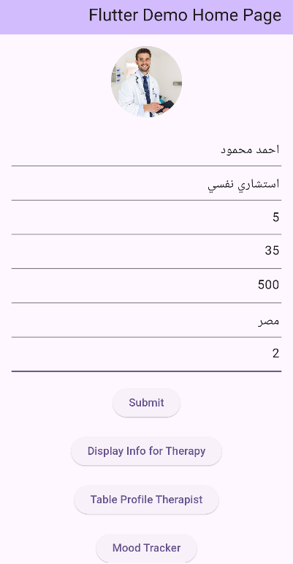
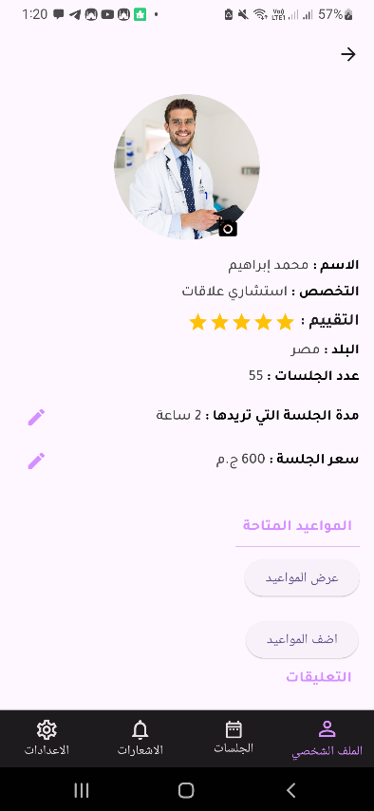
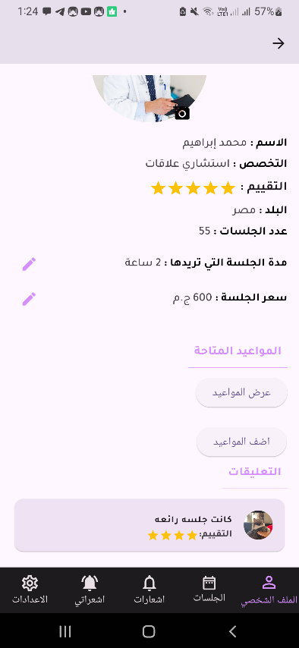
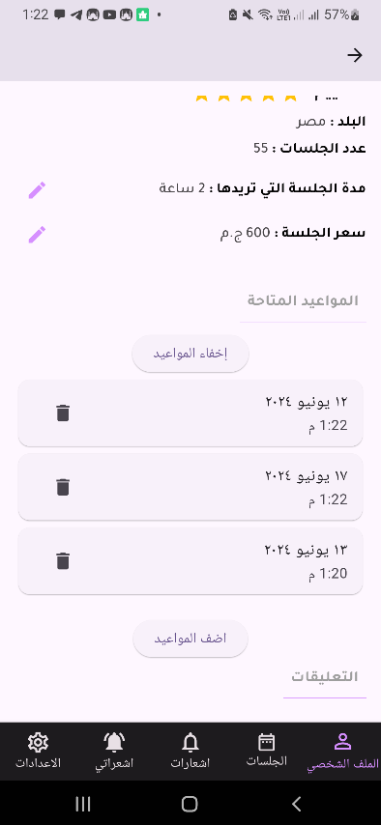
Introduction
A mobile application designed to display information about a therapist and allow users to interact with the therapist's profile. This application is developed by Flutter mobile framework.
App Functionality
1. Therapist profile
The core functionality to display therapist information, manage profile pictures, and allow user interaction (write comments).

Slide 3
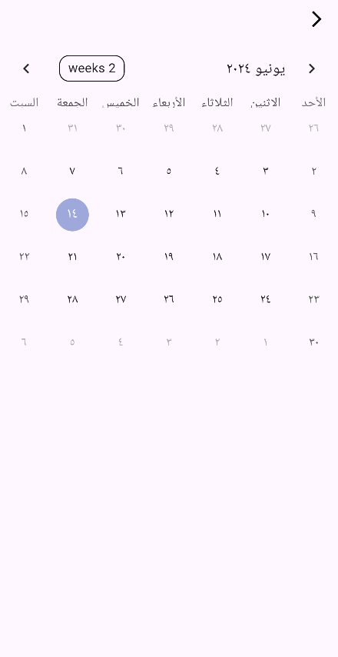
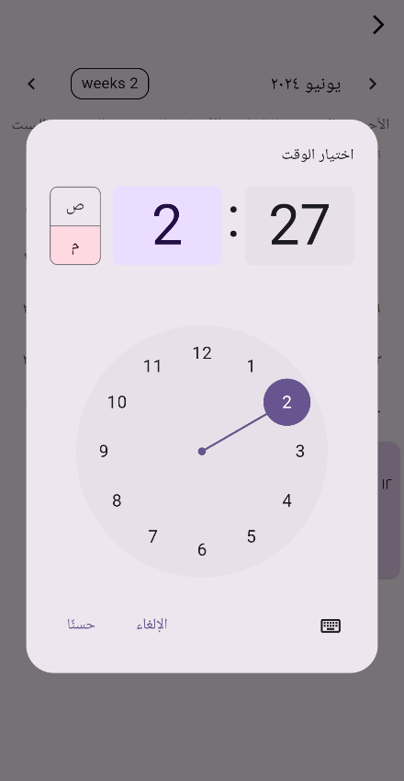
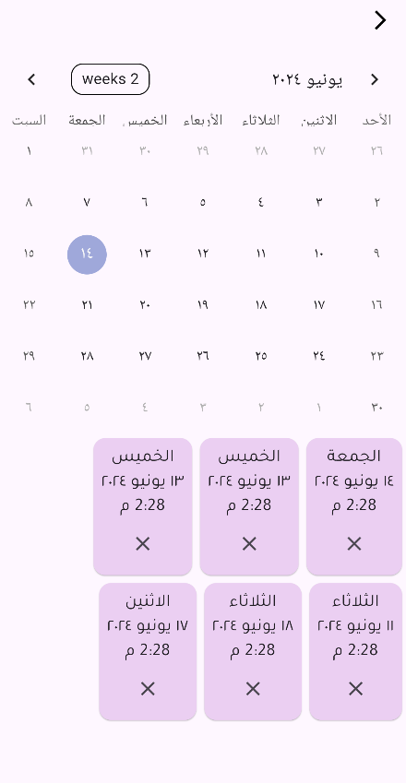
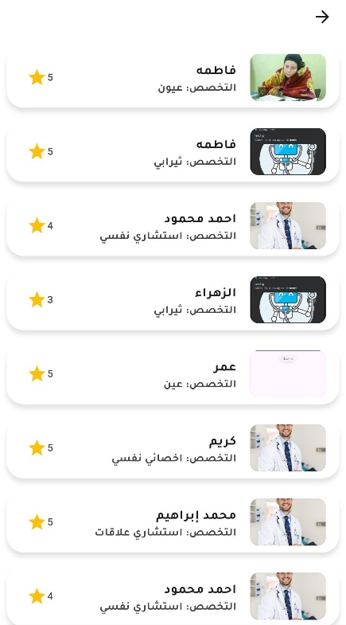
2. Edit Appointments
Therapists manage their appointments.
View Existing Appointments: Each appointment is displayed in a Card widget with the appointment details and a delete button.
Schedule New Appointments : Therapists can select dates for new appointments with Arabic locale support.
Delete Appointments
3. Therapist table
Therapist List: Each therapist is displayed
in a list item with their profile picture, name,
specialization, and rate with a star icon.

Slide 4
Technical Details
1. Therapist profile
Data Fetching and Display:
Retrieves therapist data from a Firestore database. Fetched data includes therapist name, specialization, rating, country, number of sessions, session duration, and price.
The retrieved data is then displayed on the screen.
2. Profile Picture Management:
Allows therapists to update their profile picture.
The selected image is uploaded to Firebase Storage using a unique filename generated based on therapist ID and timestamp.
3. Appointment Management:
The therapist can edit their session duration and price by clicking the edit icons next to the corresponding values.
A separate section allows therapists to view and manage their appointments.
The code retrieves appointments from Firestore based on the therapist ID and displays them in a list.
Therapists can delete appointments.
4. User Comments:
Each comment is displayed in a Card widget with the comment text, rating (represented by stars), and user profile picture (if available).

Slide 5

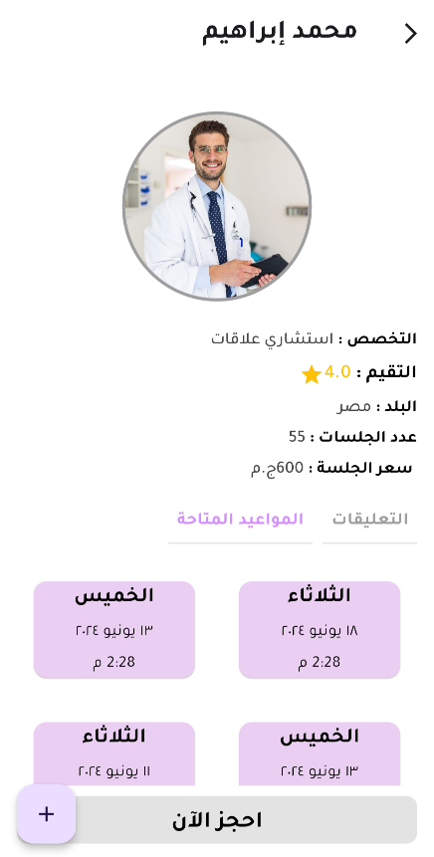
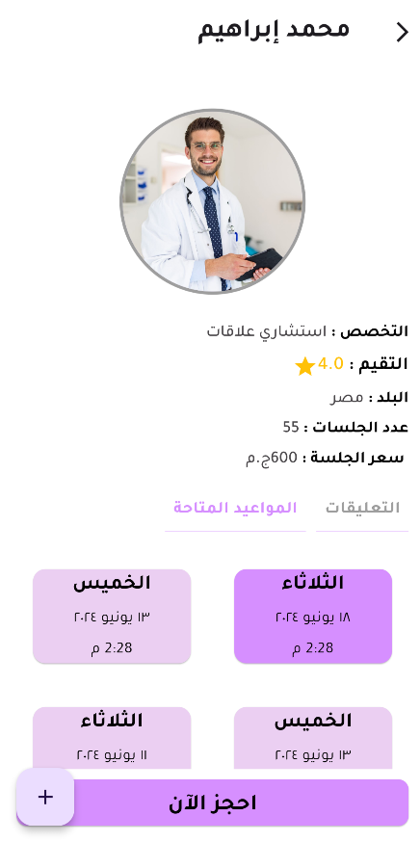
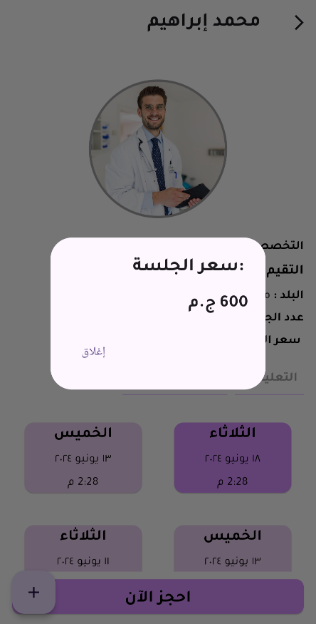
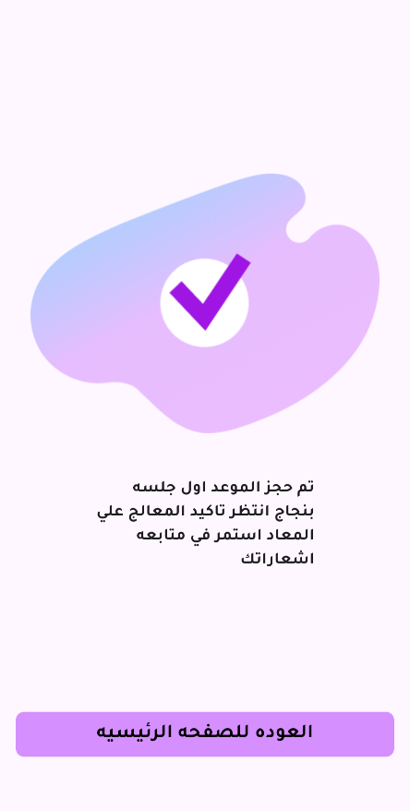
4. Therapist information:
This is a well-written Flutter code for displaying therapist details and appointments.

Slide 6
The code retrieves therapist data from a Firestore collection named 'therapists' using the widget.therapist.id.
It extracts details like name, specialization, country, sessions number, and salary.
Technical Details
1. Fetches Therapist Details:
The code retrieves therapist data from a Firestore collection named 'therapists' using the widget.therapist.id.
It extracts details like name, specialization, country, sessions number, and salary.
2. Fetches User Comments:
It retrieves user comments from a Firestore collection named 'addUserComment' based on the therapist's ID.
For each comment, it calculates the total rating and divides it by the number of comments to get the average rate.
3. Displays Therapist Information:
The therapist's name, profile picture, specialization, country, number of sessions, and salary are displayed using Text widgets and CircleAvatar for the image.
The average rating is displayed with a star icon and formatted to one decimal place.
4. Toggles Between Appointments and Comments:
Two buttons are displayed: "التعليقات" (Comments) and "المواعيد المتاحة" (Available Appointments).
Clicking a button updates the showAppointments state variable, which controls which section is visible.
5. Displays Appointments:
If "Available Appointments" is selected, a GridView builder displays appointments in a grid layout.
Each appointment card shows the date, time, and day.
Clicking an appointment card selects it and changes the card color.

Slide 7
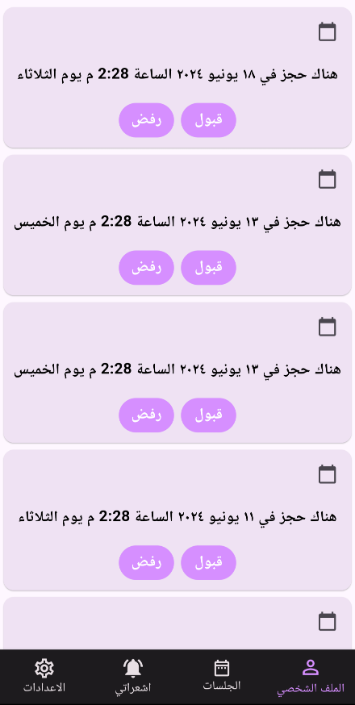
5. Notifications:
The provided code displays a list of therapist appointments for a user. Here's a breakdown of its functionality:
1. Receives Appointments:
The class receives a list of appointments (appointments) and the therapist's ID (therapistId) through the constructor.
2. Displays Appointments:
A ListView.builder builds the list of appointments.
Each appointment is displayed in a Dismissible widget, allowing users to swipe and remove the appointment.
The appointment details include date, time, and day in Arabic (هناك حجز في ${appointment['date']} الساعة ${appointment['time']} يوم ${appointment['day']}).
Two buttons are displayed below each appointment: "قبول" (Accept) and "رفض" (Reject). Clicking them triggers actions that you need to implement (e.g., update appointment status in Firestore).

Slide 8
3. Bottom Navigation Bar:
The bottom navigation bar has four icons:
"الملف الشخصي" (Profile) - Likely navigates to a therapist profile page (not implemented).
"الجلسات" (Sessions) - Currently selected, shows the list of appointments.
"اشعارتي" (My Notifications) - Potentially displays therapist-related notifications (not implemented).
"الاعدادات" (Settings) - Likely navigates to a settings page (not implemented).
4. Missing Functionality:
The code currently doesn't handle therapist information retrieval, user comments, or notification display.
The navigation for profile, settings, and potentially notifications needs to be implemented.

